Slide 1

Answers
C
A
D
B
B
C
D
A
320
340
360
380
360
390
430
495
710
775
823
866

Slide 2
600
00
9
500
10
2
700
40
1
100
20
0
800
70
3

Slide 3
Answers
<
<
<
<
>
<
661 698 724 749 783
187 253 419 526 617

Slide 4
Answers
700
700
600
500
100
500

Slide 5
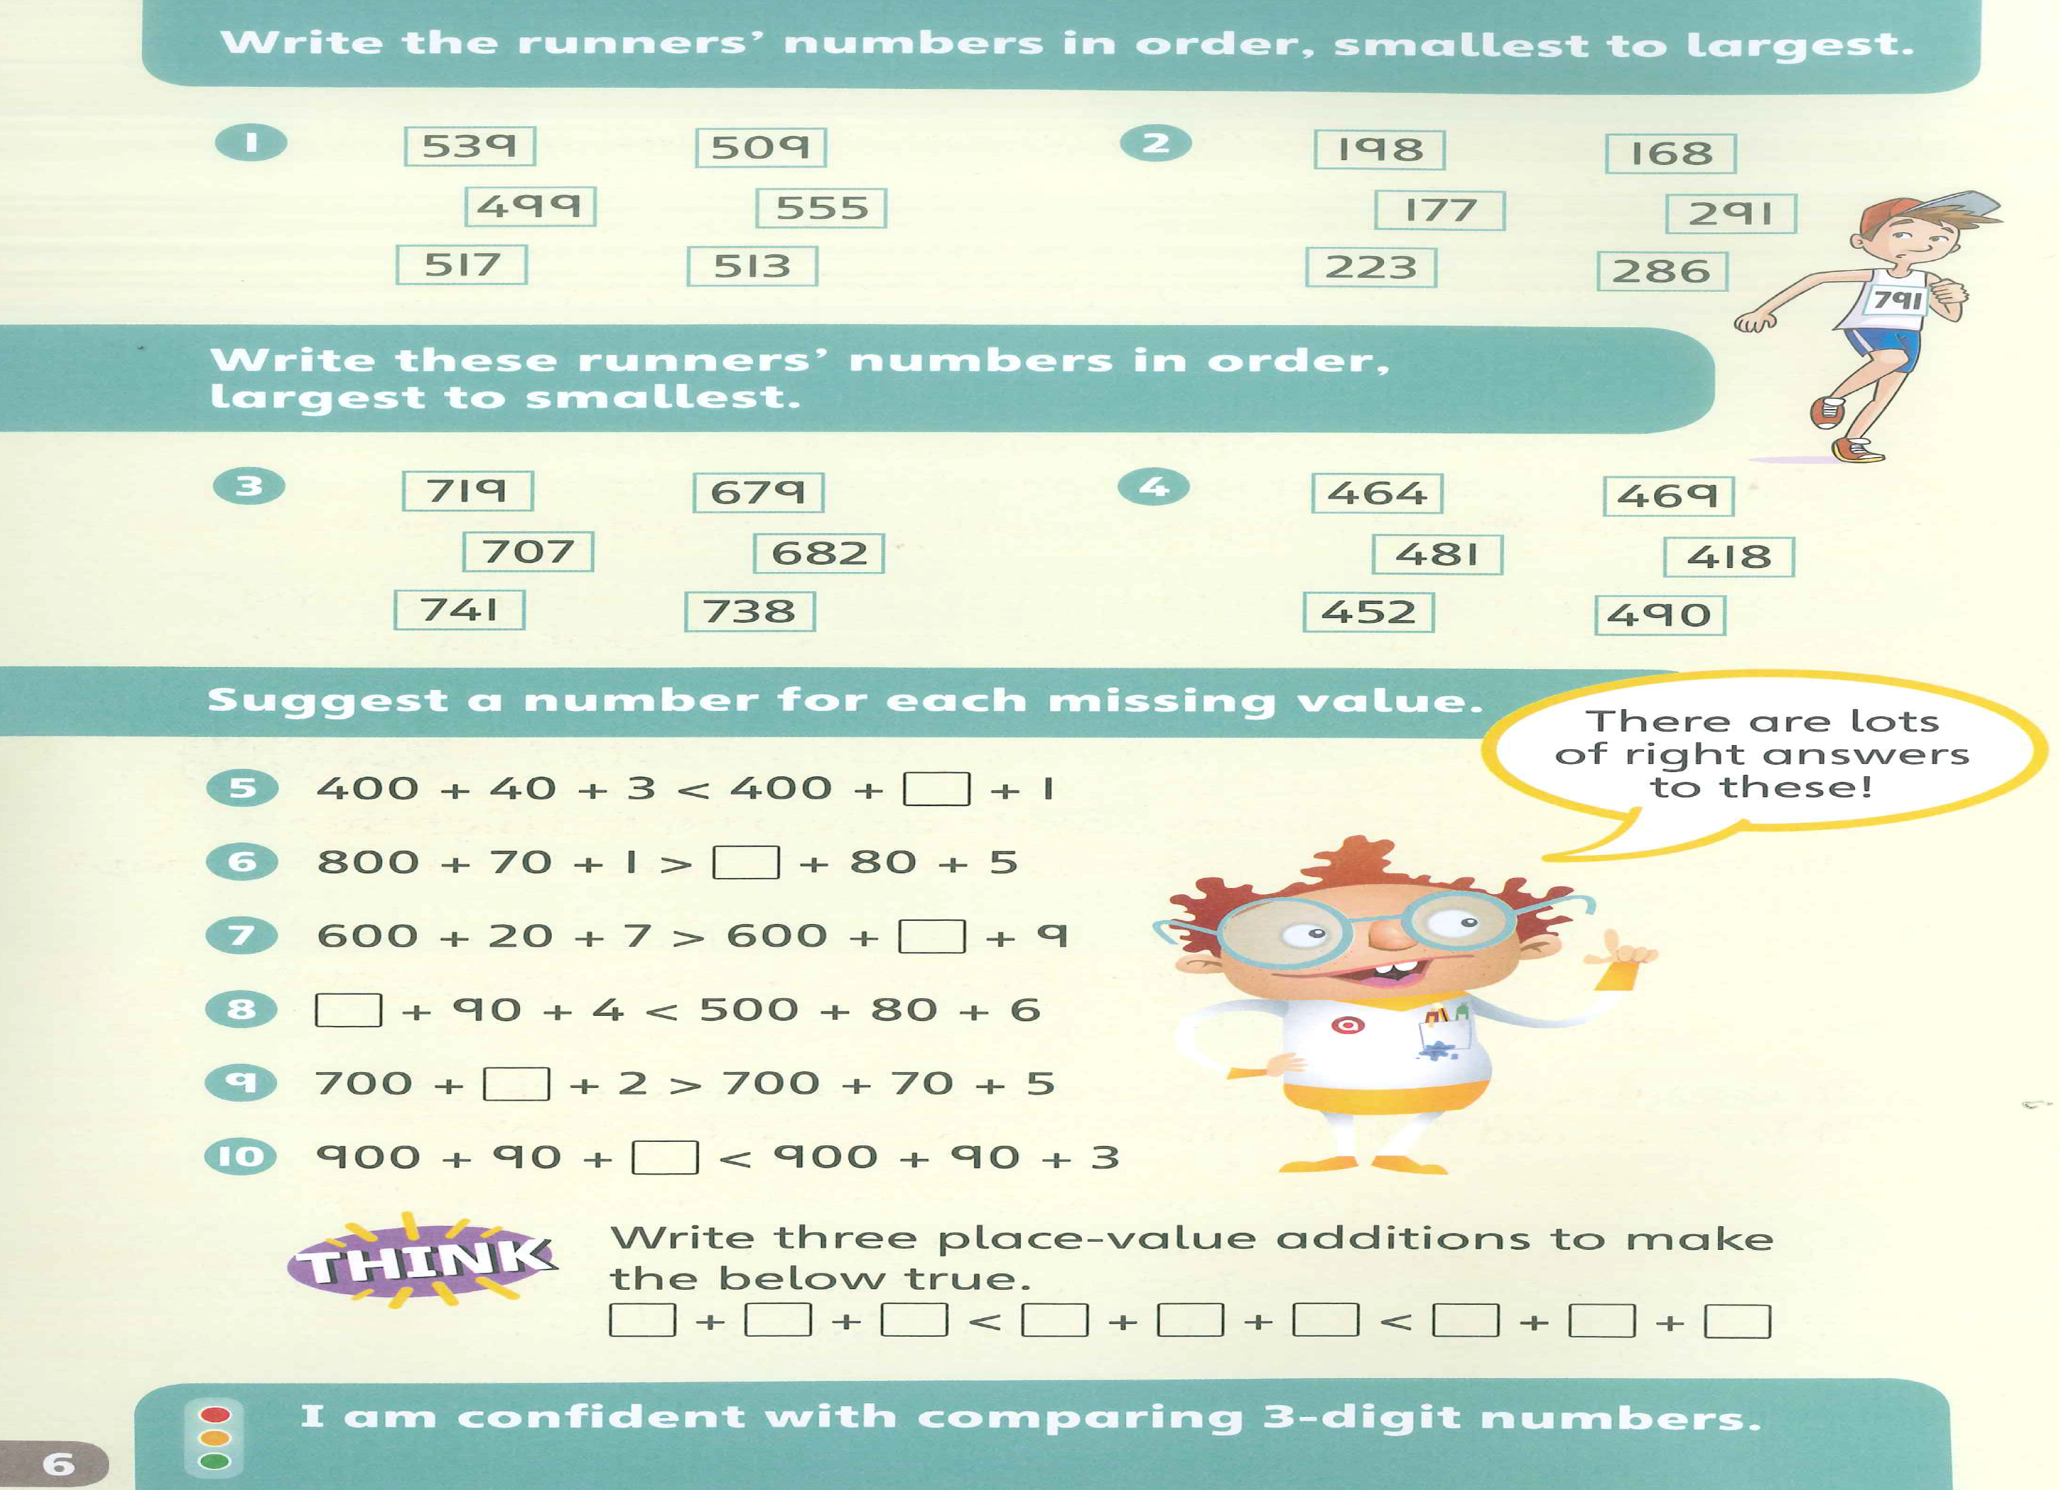
TB2 p.6
Answers
499, 509, 513, 517, 539, 555
168, 177, 198, 223, 286, 291
741, 738, 719, 707, 682, 679
490, 481, 469, 464, 452, 418

